Slide 1
Assembly Algorithm Using GraphLab
Yuge, Ayushi, Shuya

Slide 2
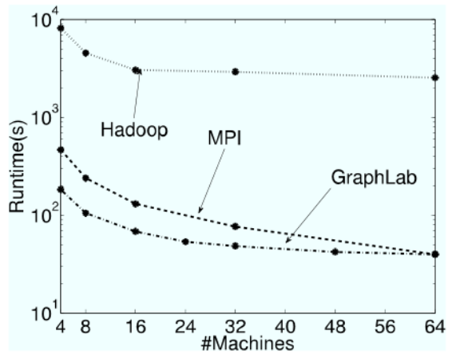
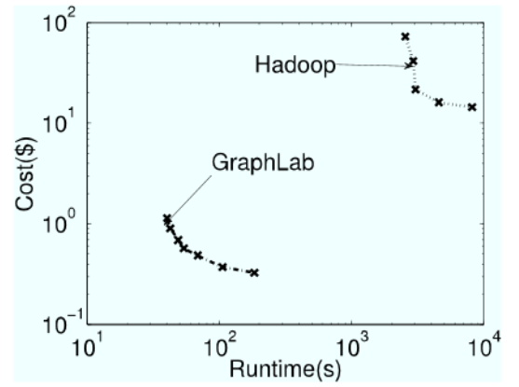
Motivation
Rather than Hadoop MapReduce, GraphLab claims to be faster than Hadoop MapReduce.

Slide 3
Input
Aligned reads after using FFT alignment.
offset with respect to reference
quality of alignment
content of reads
overlaps between adjacent reads

Slide 4
Output
An inferred DNA sequence with the best score according to our scoring mechanism.

Slide 5
Assembly Algorithm
Key
Construct a distributed graph for GraphLab
Define a scoring mechanism for the graph

Slide 6
Distributed Graph
Definition
The distributed graph G=(V,E) is a directed graph.
Vertices V = {r_1,r_2,...,r_N}, each read is a vertex.
Edge E, if there is overlap between a pair of reads, then there is an edge between them.

Slide 7
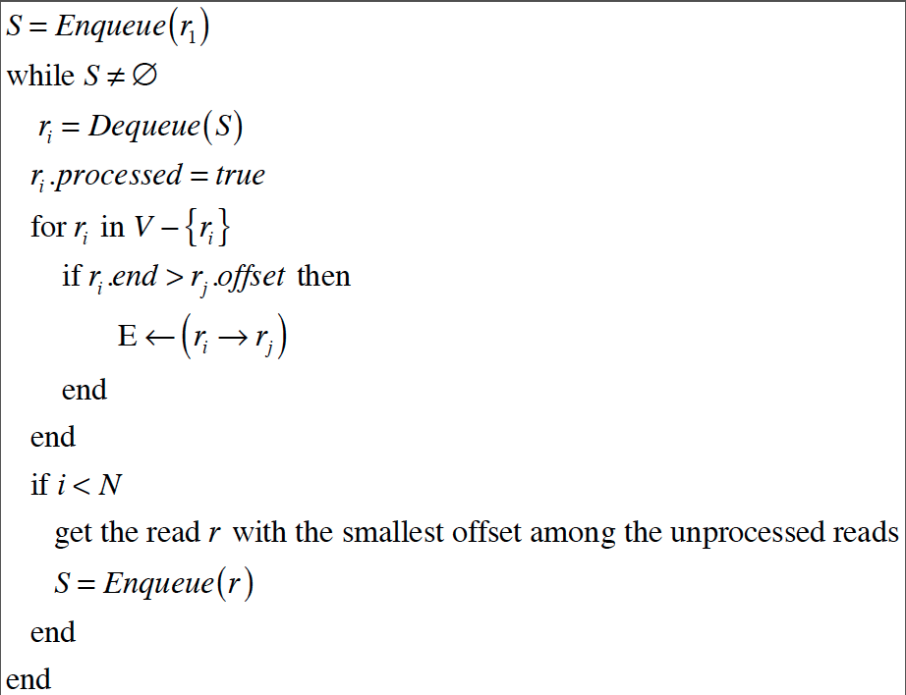
How to construct the graph

Slide 8
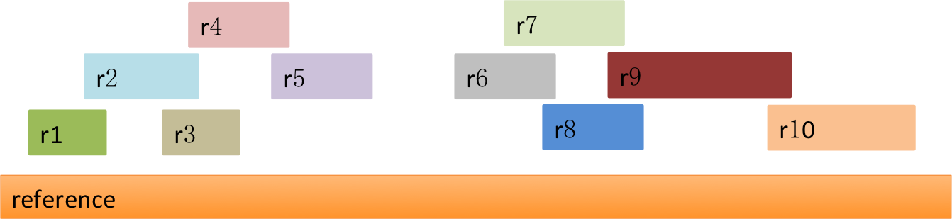
Example
Aligned reads and reference

Slide 9
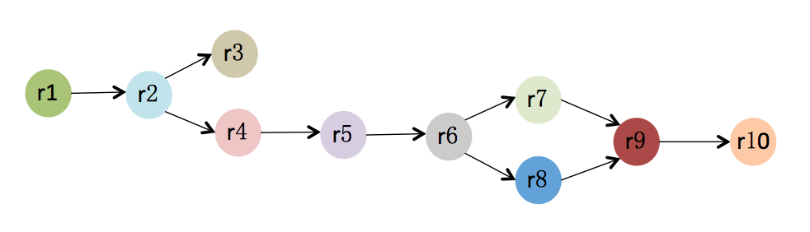
Example
Assembly graph

Slide 10
Scoring Mechanism
For reads r_i and r_j, how can we assign a weight to the directed edge r_i -> r_j or r_j -> r_i?
score_ij = quality of alignment + overlap counts between r_i and r_j
w_ij = 1/score_ij, which means reads with smaller weight are more likely to merge

Slide 11
Shortest Path
Find shortest path between r1 and r10
The topology order of reads in the path will be the reads order in the new DNA sequence

Slide 12
Merge
Given the path P=(V’,E’), we can merge the reads to get a new DNA sequence.
For two adjacent reads ri and rj
If ri.end < rj.offset, which means there is no alignment between ri and rj, we use N to connect them.

